Slide 1
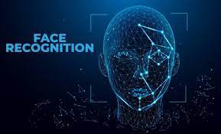
LAB2: END-TO-END MACHINE LEARNING PROJECT

Slide 2
LAB2: END-TO-END MACHINE LEARNING PROJECT “FACE DETECTION APPLICATION”
1. Feature Engineering

Slide 3
2. Binary Classification using Scikit-Learn

Slide 4
3. Evaluating the Best Face Detector

Slide 5
4. Finding Faces in a New Image

